Slide 1


Computer Graphics
Week 3 : Color Space

Slide 2
OUTLINES
RGB
Hexadecimal Number
CMYK

Slide 3
Color Space
A color space is a useful conceptual tool for understanding the color capabilities of a particular device or digital file. When trying to reproduce color on another device, color spaces can show whether you will be able to retain shadow/highlight detail, color saturation, and by how much either will be compromised.
Color spaces are the mathematical representation of a set of colors. There are many color models. Some of them are RGB, CMYK, YIQ, HSV, HLS, etc.

Slide 4
In computer graphics and photography, color space refers to a specific organization of colors.
The three most common are red, green, and blue (RGB), cyan, magenta, yellow, and key (CMYK), and hue-saturation-value (HSV).
Each color space has its own uses:
RGB is better for website images because it works with monitors.
CMYK is often used in print because it allows for more color variations.
HSV is great for editing because it separates out the lightness variations from the hue and saturation variations.

Slide 5
1. RGB

Slide 6
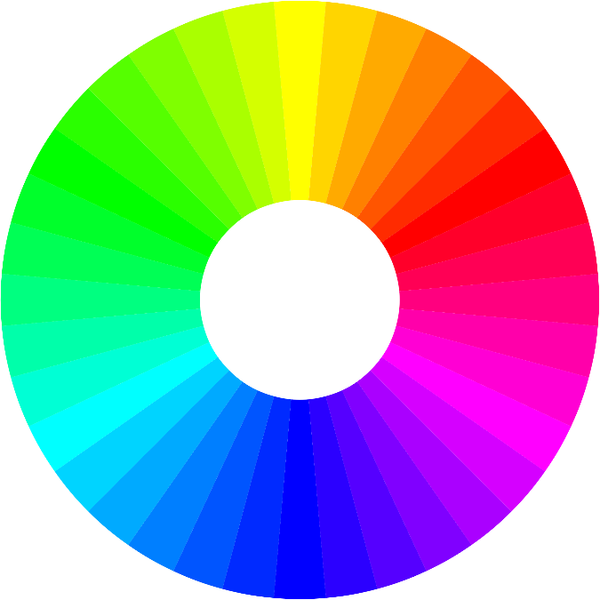
RGB
The RGB color model is an additive color model in which Red, Green and Blue light are added together in various ways to reproduce a broad array of colors. The name of the model comes from the initials of the three additive primary colors, Red, Green, and Blue.

Slide 7
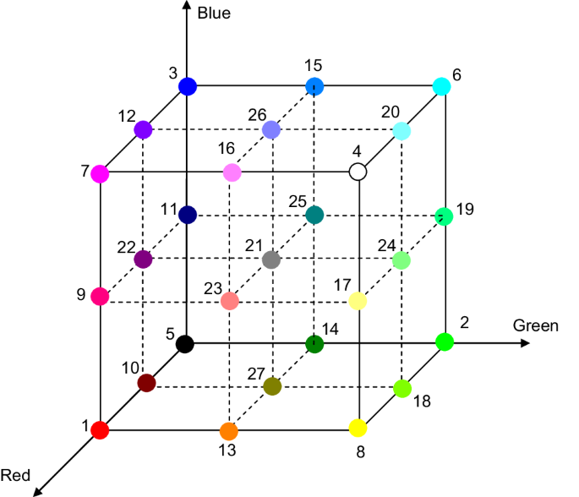
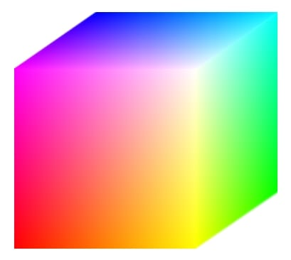
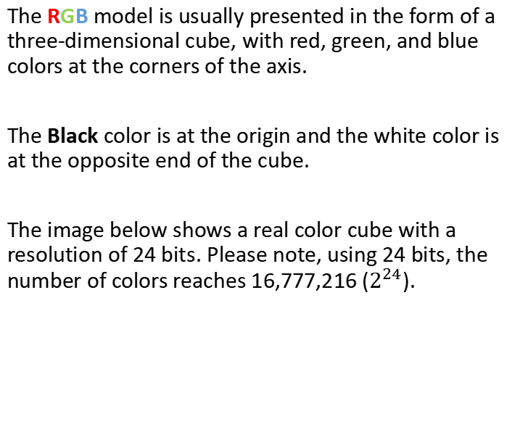
The RGB model is usually presented in the form of a three-dimensional cube, with red, green, and blue colors at the corners of the axis.
The Black color is at the origin and the white color is at the opposite end of the cube.
The image below shows a real color cube with a resolution of 24 bits. Please note, using 24 bits, the number of colors reaches 16,777,216 ($2^{24}$).
RGB color space scheme in cubes

Slide 8
The Red, Green and Blue use 8 bits each, which have integer values from 0 to 255. This makes 256*256*256 = 16.777.216 possible colors.
Each pixel in the LED monitor displays colors this way, by combination of Red, Green and Blue LEDs (Light Emitting Diodes).
When the Red pixel is set to 0, the LED is turned off. When the Red pixel is set to 255, the LED is turned fully on.

Slide 9
RGB : Additive
Additive colors are colors that come from light and are called spectrum. RGB is obtained from parsing light.
The color is expressed as an RGB triplet (R,G,B), each component of which can vary from zero to a defined maximum value. If all the components are at zero the result is black; if all are at maximum, the result is the brightest representable white.

Slide 10
RGB ranges quantified
RGB ranges may be quantified in several different ways:
From 0 to 1, with any fractional value in between. This representation is used in theoretical analyses, and in systems that use floating point representations.
Each color component value can also be written as a percentage, from 0% to 100%.
In computers, the component values are often stored as integer numbers in the range 0 to 255, the range that a single 8-bit byte can offer. These are often represented as either decimal or hexadecimal numbers.
High-end digital image equipment are often able to deal with larger integer ranges for each primary color, such as 0 … 1023 (10 bits), 0 … 65.535 (16 bits) or even larger (more or less independent from the particular computer's word size).

Slide 11
For example, brightest saturated red is written in the different RGB notations as:
Notation | RGB triplet
Arithmetic | (1.0, 0.0, 0.0)
Percentage | (100%, 0%, 0%)
Digital 8-bit per channel | (255, 0, 0) or sometimes #FF0000 (hexadecimal)
Digital 12-bit per channel | (4.095, 0, 0)
Digital 16-bit per channel | (65.535, 0, 0)
Digital 24-bit per channel | (16.777.215, 0, 0)
Digital 32-bit per channel | (4.294.967.295, 0, 0)

Slide 12
2. Hexadecimal Number

Slide 13
Decimal Number
Decimal number system is the most commonly used and the most familiar one to the general public.
Also known as Base 10 numbering system since it is based on 10 following symbols: 0, 1, 2, 3, 4, 5, 6, 7, 8 and 9.
In decimal system, every digit has its own position as well as the decimal point. I.e. the number 356.74 has 4 in the Hundredths position, 7 in the Tenths position, 6 in the Units position, 5 in the Tens position, and 3 in the Hundreds position.
Decimal number system is also one of the oldest known numeral system, which is historically related to Hindu-Arabic numeral system.

Slide 14
Hexadecimal Number
Hex, or hexadecimal, is a number system of base 16.
This number system is especially interesting because in our casually used decimal system we have only 10 digits to represent numbers.
As hex system has 16 digits, the extra needed 6 digits are represented by the first 6 letters of English alphabet.
Hence, hex digits are 0,1,2,3,4,5,6,7,8 and 9 A, B, C, D, E, F.
This number system is the most commonly used in mathematics and information technologies. I.e. in html programming colors can be represented by a 6-digit hexadecimal number: FFFFFF represents white, 000000 represents black, and so on.

Slide 15
Hex representation
Uses 10 digits and 6 letters, 0,1,2,3,4,5,6,7,8,9,A,B,C,D,E,F.
Letters represents numbers starting from 10.
A = 10, B = 11, C = 12, D = 13, E = 14, F = 15.
Also called base 16 number system.
Each position in a hexadecimal number represents a 0 power of the base (16). Example 16⁰.
Last position in a hexadecimal number represents an x power of the base (16). Example 16^{x} where x represents the last position - 1.

Slide 16

Converting Decimal To Hexadecimal
Decimal to hex conversion examples:
$${(79)}_{10}={(4F)}_{16}$$
$${(120)}_{10}={(78)}_{16}$$
$${(1728)}_{10}={(6C0)}_{16}$$

Slide 17
Converting Decimal To Hexadecimal (2)
Steps:
Divide the decimal number by 16. Treat the division as an integer division.
Write down the remainder (in hexadecimal).
Divide the result again by 16. Treat the division as an integer division.
Repeat step 2 and 3 until result is 0.
The hex value is the digit sequence of the remainders from the last to first.

Slide 18
Convert the number 1128 DECIMAL to HEXADECIMAL
NOTES | DIVISION | RESULT | REMAINDER (in HEX)
Start by dividing the number by 16, that is (1128 / 16 = 70.5). So the integer division result is 70 (throw out anything after the decimal point). --> Record it on the RESULT column. The remainder is (70.5 - 70) multiplied with 16; or (0.5 times 16), which is 8. Record it on the REMAINDER column. | 1128 / 16 | 70 | 8
Then, divide the result again by 16, that is (70 / 16 = 4.375). So the integer division result is 4 (throw out anything after the decimal point) The remainder is (0.375 multiplied with 16, which is 6. | 70 / 16 | 4 | 6
Note here that 4 / 16 = 0.25. So the integer division result is 0. The remainder is (0.25 - 0) multiplied with 16, which is 4. | 4 / 16 | 0 | 4
Stop because the result is already 0 (0 divided by 16 will always be 0)
Well, here is the answer. These numbers come from the REMAINDER column values (read from bottom to top) |  |  | 468

Slide 19
Convert the number 188 DECIMAL to HEXADECIMAL
DIVISION | RESULT | REMAINDER (in HEX)
188 / 16 | 11 | C (12 decimal)
11 / 16 | 0 | B (11 decimal)
ANSWER |  | BC

Slide 20

Converting Hexadecimal to Decimal
Convert the number 1128 HEXADECIMAL to DECIMAL
$1×\left({16}^{3}\right)+1×\left({16}^{2}\right)+2×\left({16}^{1}\right)+8×\left({16}^{0}\right)=4392$
Convert the number 1531 HEXADECIMAL to DECIMAL
$1×\left({16}^{3}\right)+5×\left({16}^{2}\right)+3×\left({16}^{1}\right)+1×\left({16}^{0}\right)=5425$

Slide 21

Hexadecimals Color
Decimal: | Binary: | Hexadecimal:
0 | 0 | 0
1 | 1 | 1
2 | 10 | 2
3 | 11 | 3
4 | 100 | 4
5 | 101 | 5
6 | 110 | 6
7 | 111 | 7
8 | 1000 | 8
9 | 1001 | 9
10 | 1010 | A
11 | 1011 | B
12 | 1100 | C
13 | 1101 | D
14 | 1110 | E
15 | 1111 | F
1 byte = 8 bit (10101011)
$2^{8}=256$ (0 … 255)
FOUR binary digits make ONE hexadecimal digit

Slide 22
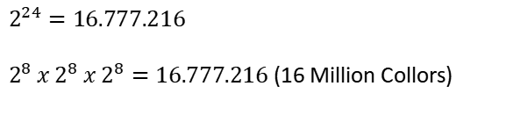
Hexadecimals Color (2)
ONE hexadecimal digit can have 16 different values (0 to 15 in decimal)
TWO hexadecimal digits together (called a "byte“, 1 byte = 8 bit) can make 16 × 16 = 256 different levels of color.
0 to 255 (in decimal) or 00 to FF (in hexadecimal)
$$2^{24}=16.777.216$$
$2^{8} x 2^{8} x 2^{8}=16.777.216$ (16 Million Collors)
1 | 1 | 1 | 1 | 1 | 1 | 1 | 1 | 1 | 1 | 1 | 1 | 1 | 1 | 1 | 1 | 1 | 1 | 1 | 1 | 1 | 1 | 1 | 1
F | F | F | F | F | F

Slide 23
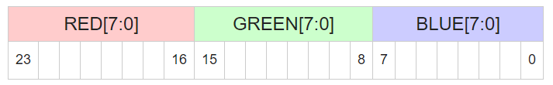
RGB Color Format & Calculation. RGB code has 24 bits format (bits 0…23):
RGB = (R*65536) + (G*256) + B
White RGB code = (255*65.536) + (255*256) + 255 = 16.777.215 = #FFFFFF
Blue RGB code = (0*65.536) + (0*256) + 255 = 255 = #0000FF
Red RGB code = (255*65.536) + (0*256) + 0 = 16.711.680 = #FF0000
Green RGB code = (0*65.536) + (255*256) + 0 = 65.280 = #00FF00
Gray RGB code = (128*65.536) + (128*256) + 128 = 8.421.504 = #808080
Yellow RGB code = (255*65.536) + (255*256) + 0 = 16.776.960 = #FFFF00

Slide 24
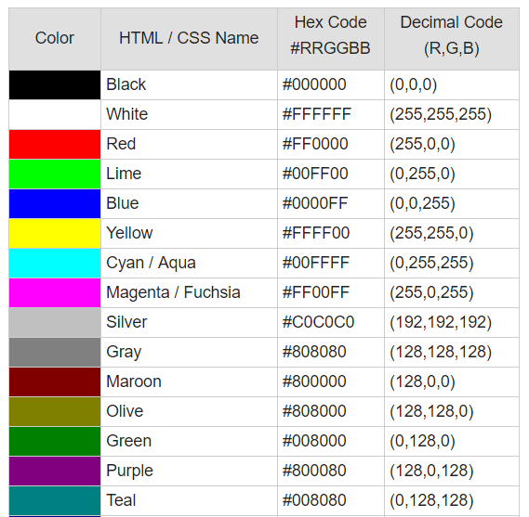
Basic Colors:

Slide 25

Convert to binary : ${(13)}_{10}$ = ${(1101)}_{2}$
Convert to hexadecimal : ${(13)}_{10}$ = ${(D)}_{16}$
DIVISION | RESULT | REMAINDER (in BIN)
13/2 | 6 | 1
6/2 | 3 | 0
3/2 | 1 | 1
1/2 | 0 | 1
DIVISION | RESULT | REMAINDER (in HEX)
13/16 | 0 | D (13 in Decimal)
$$1101= 1x2^{0}+0x2^{1}+1x2^{2}+1x2^{3}=13$$
Change into 24 bits
#00000D
0 | 0 | 0 | 0 | 0 | 0 | 0 | 0 | 0 | 0 | 0 | 0 | 0 | 0 | 0 | 0 | 0 | 0 | 0 | 0 | 1 | 1 | 0 | 1
0 | 0 | 0 | 0 | 0 | D

Slide 26
Convert to binary : ${(\text{65}\text{.}\text{280})}_{10}$ = ${(1111111000000)}_{2}$
Convert to hexadecimal : ${(\text{65}\text{.}\text{280})}_{10}$ = ${(…)}_{16}$
DIVISION | RESULT | REMAINDER (in BIN)
65.280/2 | 32.640 | 0
32.640/2 | 16.320 | 0
16.320/2 | 8.160 | 0
8.160/2 | 4.080 | 0
… | … | …
DIVISION | RESULT | REMAINDER (in HEX)
65.280/16 | 4.080 | 0 (0 in Decimal)
4.080/16 | 255 | 0 (0 in Decimal)
255/16 | 15 | F (15 in Decimal)
15/16 | 0 | F (15 in Decimal)
Change into 24 bits
#00FF00
0 | 0 | 0 | 0 | 0 | 0 | 0 | 0 | 1 | 1 | 1 | 1 | 1 | 1 | 1 | 1 | 0 | 0 | 0 | 0 | 0 | 0 | 0 | 0
0 | 0 | F | F | 0 | 0

Slide 27
Convert to binary : ${(\text{8}\text{.}\text{421}\text{.}\text{504})}_{10}$ = ${(…)}_{2}$
Convert to hexadecimal : ${(\text{8}\text{.}\text{421}\text{.}\text{504})}_{10}$ = ${(…)}_{16}$
DIVISION | RESULT | REMAINDER (in BIN)
8.421.504/2 | 4.210.752 | 0
4.210.752/2 | 2.105.376 | 0
2.105.376/2 | 1.052.688 | 0
1.052.688/2 | 526.344 | 0
… | … | …
DIVISION | RESULT | REMAINDER (in HEX)
8.421.504/16 | 526.344 | 0 (0 in Decimal)
526.344/16 | 32.896 | 8 (8 in Decimal)
32.896/16 | 2.056 | 0 (0 in Decimal)
2.056/16 | 128 | 8 (8 in Decimal)
… | … | …
Change into 24 bits
#808080
1 | 0 | 0 | 0 | 0 | 0 | 0 | 0 | 1 | 0 | 0 | 0 | 0 | 0 | 0 | 0 | 1 | 0 | 0 | 0 | 0 | 0 | 0 | 0
8 | 0 | 8 | 0 | 8 | 0

Slide 28
The R,G,B values are divided by 255, to change the range from 0 … 255 to 0 ... 1:
R’ = R/255
G’ = G/255
B’ = B/255

Slide 29
3. CMYK

Slide 30
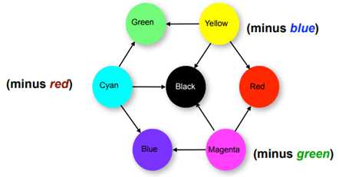
CMYK
CMYK stands for Cyan, Magenta, Yellow and Black.
CMYK color model is used in electrostatic and ink-jet plotters which deposits the pigmentation on paper. In these model, specified color is subtracted from the white light rather than adding blackness. It follows the Cartesian coordinate system and its subset is a unit cube.

Slide 31
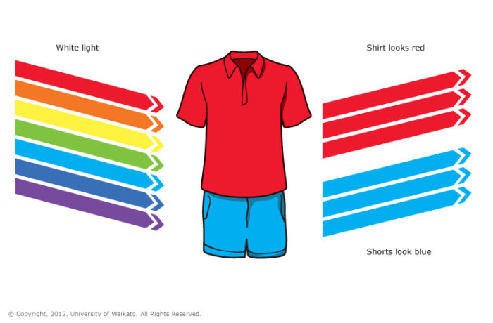
How does CMYK Color Work?
The CMYK color model is based off of the fact that surfaces appear to be certain colors because of the wavelengths of light they absorb and reflect.
For example, things that appear to be red will only reflect red light. Objects that appear to be white will reflect all wavelengths of light, and objects that appear black absorb all wavelengths (which is why you should avoid wearing black in the summer to stay cool).

Slide 32
In theory, the mixture of these three pigments (CMY) in a balanced size will produce shades of gray, and will become black if all three are fully saturated, but in practice the results tend to be brownish dirty.
Therefore, the fourth color is often used, namely black, in addition to cyan, magenta and yellow. The resulting color space is then called CMYK (Cyan, Magenta, Yellow, Black). Black is called "K" (Key) from the term "key plate" in printing (the printing plate that creates artistic details in the image, usually using the color of black ink).

Slide 33
Conversion CMY to CMYK
The amount of the black component needed is conventionally specified by the letter K.
CMYK values are typically reported as percentages. Ideal CMYK values can be calculated by simple formulae directly from CMY values, but these values are not accurate for colour printing (Ford and Roberts, 1998)
Black (K) = min(C,M,Y)
Cyan_{CMYK} = (C - K) / (1 - K)
Magenta_{CMYK} = (M - K) / (1 - K)
Yellow_{CMYK} = (Y - K) / (1 - K)
In this case, if K = 1 then C=M=Y=0
Alternative formula (Crane, 1997)
Black (K) = min(C,M,Y)
Cyan_{CMYK} = C - K
Magenta_{CMYK} = M - K
Yellow_{CMYK} = Y - K
With this approach, one of Cyan_{CMYK}, Magenta_{CMYK}, or Yellow_{CMYK} will be 0

Slide 34
CMYK : Subtractive
Computer screens display colors using RGB color values.
Printers often presents colors using CMYK color values.
In additive color models, such as RGB, white is the "additive" combination of all primary colored lights, while black is the absence of light.
In the CMYK model, it is the opposite: white is the natural color of the paper or other background, while black results from a full combination of colored inks.
Subtractive colors are colors that come from materials and are called pigments.

Slide 35
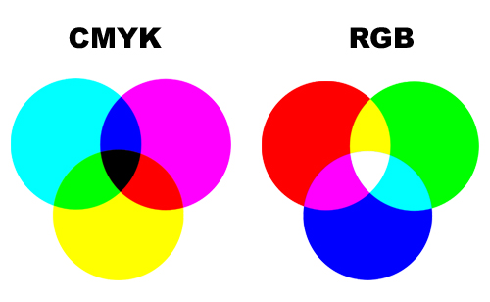
INK vs LIGHT

Slide 36
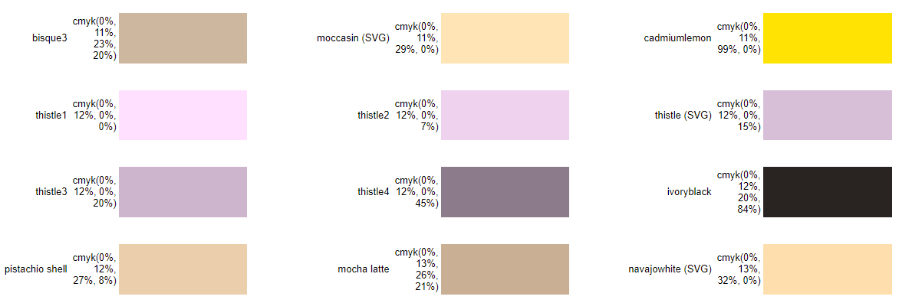
CMYK color are the percent values (C%, M%, Y%, K%),

Slide 37
Conversion RGB to CMYK
Since RGB and CMYK spaces are both device-dependent spaces, there is no general conversion formula that converts between them (can't guarantee 100% precisely).
The R,G,B values are divided by 255 to change the range from 0 … 255 to 0 .... 1:
R' = R/255
G' = G/255
B' = B/255
The Black key (K) color is calculated from the Red (R’), Green (G') and Blue (B') colors:
K = 1-max(R', G', B’)
Cyan color (C) is calculated from Red (R') and Black (K) colors:
C = (1-R'-K) / (1-K)
Magenta color (M) is calculated from Green (G') and Black (K) colors:
M = (1-G'-K) / (1-K)
Yellow color (Y) is calculated from Blue (B') and Black (K) colors:
Y = (1-B'-K) / (1-K)

Slide 38
Conversion CMYK to RGB
R,G,B values are given in the range of 0 ... 255.
Red (R) color is calculated from Cyan (C) and Black (K) colors:
R = 255 × (1-C) × (1-K)
Green (G) color is calculated from Magenta (M) and Black (K) colors:
G = 255 × (1-M) × (1-K)
Blue (B) color is calculated from Yellow (Y) and Black (K) colors:
B = 255 × (1-Y) × (1-K)

Slide 39
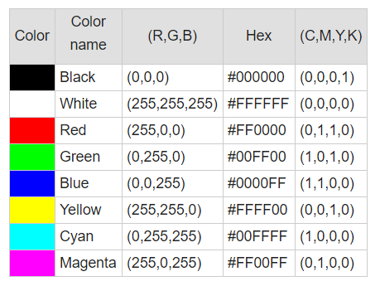
RGB to CMYK Table

Slide 40
exercise
Convert RGB (175, 230, 200) to CMYK !
Answer :
R' = R/255 → 175/255 = 0.686275
G' = G/255 → 230/255 = 0.901961
B' = B/255 → 200/255 = 0.784314
K = 1-max(R', G', B’) → 1 - 0.901961 = 0.098039
C = (1-R'-K) / (1-K) → (1 - 0.686275 - 0.098039) / (1 - 0.098039) = 0.23913
M = (1-G'-K) / (1-K) → (1 - 0.901961 - 0.098039) / (1 - 0.098039) = 0
Y = (1-B'-K) / (1-K) → (1 - 0.784314 - 0.098039) / (1 - 0.098039) = 0.130435

Slide 41
result
But the result of the color calculation is still in the form of normalization, it must be returned to the original color form by multiplying by 255 (maximum color value), So the result of the conversion becomes:
K = 0.098039 * 255 = 25
C = 0.23913 * 255 = 60.97826
M = 0 * 255 = 0
Y = 0.130435 * 255 = 33.26087

Slide 42
end of presentation
THANKYOU

